Slide 1
Digital Portfolio
STUDENT NAME: Karthika.P
REGISTER NO AND NMID:1FC91EB1732CA8781A3489C449A43664
DEPARTMENT: BSc.Artificial Intelligence And Machine Learning
COLLEGE: KPR College of Arts Science And Research

Slide 2
PROJECT TITLE Creative Portfolio Website-Graphic Designer

Slide 3


AGENDA
Problem Statement
Project Overview
End Users
Tools and Technologies
Portfolio design and Layout
Features and Functionality
Results and Screenshots
Conclusion
Github Link
3/21/2024 Annual Review

Slide 4

PROBLEM STATEMENT Aspiring or professional graphic designers often struggle to showcase their skills, creativity, and versatility to potential clients or employers in a compelling and organized way. Traditional resumes or scattered social media posts fail to communicate their design capabilities effectively. There is a need for a centralized, visually impactful, and user-friendly portfolio platform that allows a designer to present their work, design philosophy, and contact information in a professional manner

Slide 5

PROJECT OVERVIEW This project is a personal portfolio website designed and developed for a graphic designer to professionally showcase their creative work, skills, and personal brand. Built entirely using HTML and CSS, the website focuses on clean design, responsiveness, and user-friendly navigation to ensure an engaging experience for visitors, clients, or potential employers. The portfolio includes structured sections such as a landing page, about section, education, skills, my projects, and a contact form. Each section is styled with custom CSS to maintain a cohesive visual identity that reflects the designer’s style and aesthetic. The goal of this project is to provide a visually appealing and functional platform that not only highlights the designer’s previous projects but also enhances their professional online presence.

Slide 6
WHO ARE THE END USERS? 1.Potential Clients: Who they are: Individuals or businesses looking to hire a graphic designer for freelance or contract work (e.g., branding, logos, posters, UI design). What they want: To view previous projects, assess design style, and get in touch for work. 2.Hiring Managers & Recruiters: Who they are: Employers or HR professionals seeking creative talent for full-time or part-time positions. What they want: To evaluate the designer's skills, education, and experience to decide if they're a good fit for a job opportunity. 3.Design Agencies or Studios: Who they are: Agencies scouting fresh talent for collaboration or team expansion. What they want: To assess whether the designer’s portfolio aligns with their creative direction and standards. 4.Peers and Collaborators: Who they are: Fellow designers, developers, or creative professionals. What they want: To explore work for inspiration, networking, or possible collaboration. 5.Instructors or Mentors: Who they are: Teachers, mentors, or reviewers assessing the portfolio for academic or training purposes. What they want: To review the presentation of work, creativity, and growth in skills. 6.General Visitors / Fans of Design: Who they are: People interested in design who may be browsing out of curiosity or appreciation. What they want: To enjoy creative work and possibly follow or share the designer’s content.

Slide 7

TOOLS AND TECHNIQUES 1.Frontend Technologies: HTML5-For structuring the content and sections of the website. CSS3-For styling ,layout design ,and responsiveness Javascript-For interactivity ,form validation. 2.Development Environment: Visual Studio Code-As the primary code editor. 3.Version Control & Development: Git & GitHub-For source code management and collaboration.

Slide 8
POTFOLIO DESIGN AND LAYOUT
Header
Displays name, role, and contact details.
Uses a gradient background for visual appeal.
Navigation Bar
Provides quick links to different sections: About, Skills, Education, Projects, Works, Contact.
About Section
Short introduction about me, highlighting passion and creative interests.
Skills Section
Divided into Technical Skills (HTML, CSS, JS, Python, SQL, Analytics)
and Creative Skills (Drawing, Writing, Designing, UI/UX).
Education Section
Academic background with institution names and years of study.
8

Slide 9
POTFOLIO DESIGN AND LAYOUT
6.Projects Section
Highlights academic and personal projects with descriptions.
7.Contact Section
Includes a contact form with name, email, and message fields.
JavaScript used for form validation & feedback alert.
8.Footer
Contains copyright information and quick contact link.

Slide 10
FEATURES AND FUNCTIONALITY 1.Responsive Design Works smoothly on desktops, tablets, and mobile devices using flexible layouts and CSS grid. 2.Interactive Navigation A fixed navigation bar with smooth scrolling to different sections. 3.Skills & Education Display Clear separation of technical skills and creative skills, along with academic background 4.Projects Section Showcases academic and personal projects with short descriptions. 5.Contact Form Simple form for visitors to send messages. Includes JavaScript validation and confirmation alert. 6.Modern UI Elements Hover effects on cards, gradient header, soft shadows, and rounded corners for a professional look. 7.Easy Deployment Can be hosted on GitHub Pages or Netlify for public access.

Slide 11
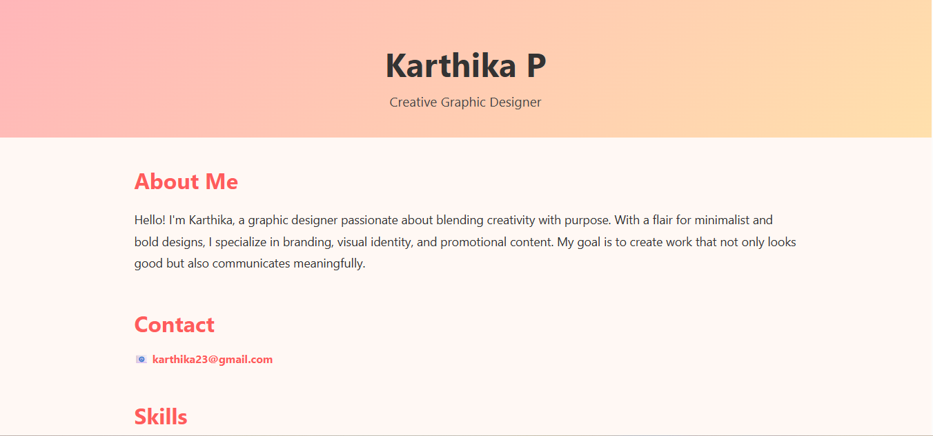
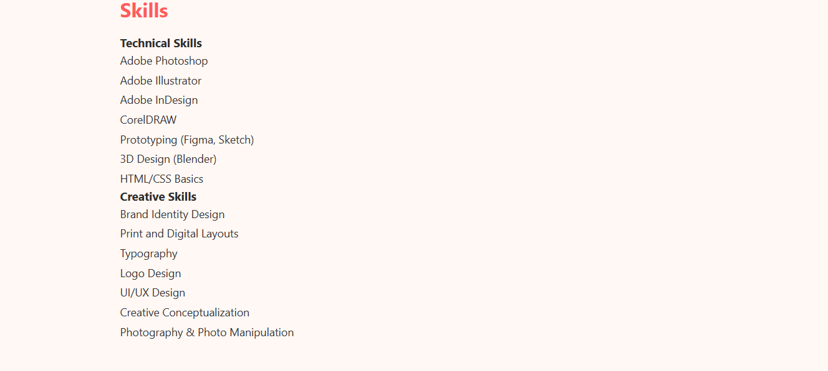

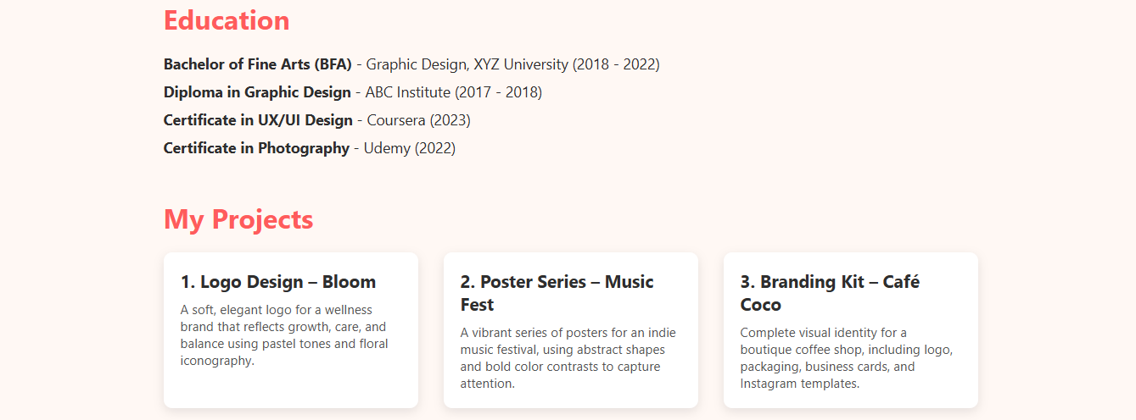
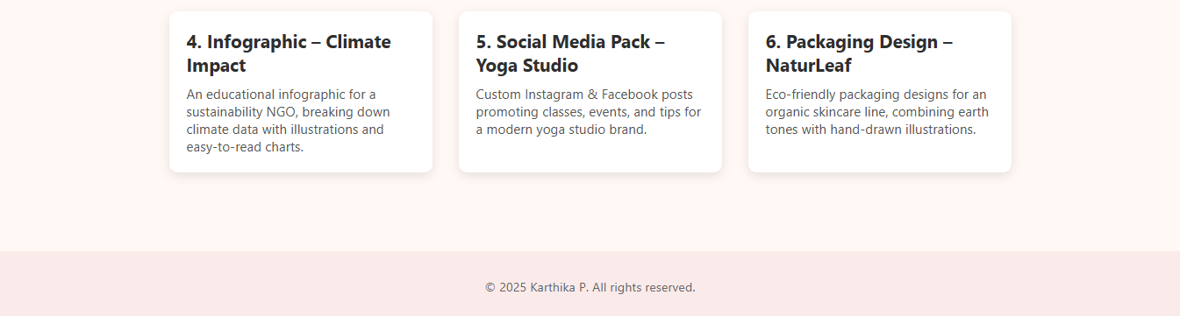
RESULTS AND SCREENSHOTS A fully responsive Graphic Designer Portfolio Website was developed using HTML, CSS, and JavaScript. It showcases About, Skills, Education, Projects, and Creative Works in a clear and professional layout. Interactive features like hover effects, navigation, and a contact form enhance usability and presentation
3/21/2024 Annual Review
11

Slide 12
CONCLUSION The Graphic Designer Portfolio developed using HTML and CSS successfully serves as a digital platform to showcase the designer's creativity, skills, and professional background in a clean, organized, and visually appealing manner. By including key sections such as About Me, Education, Skills, My Projects, and Contact Details, the portfolio offers a comprehensive view of the designer’s capabilities to potential clients, employers, and collaborators. This project not only highlights the designer’s graphic design work but also demonstrates foundational web development skills through the use of semantic HTML and custom CSS styling. The responsive layout ensures a smooth user experience across different devices, enhancing accessibility and engagement. Overall, the portfolio fulfills its purpose as a personal branding tool, making it easier for the designer to establish a professional online presence, attract opportunities, and grow their creative career.
12

Slide 13
GitHub link
https://github.com/Karthika287/naan-mudhalvan.git

